Slide 1
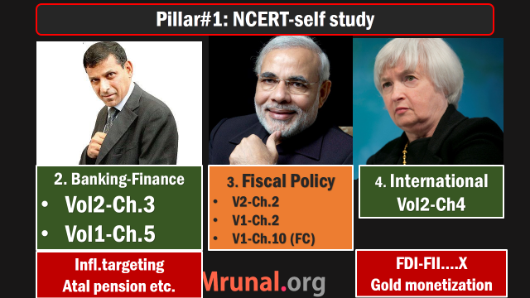
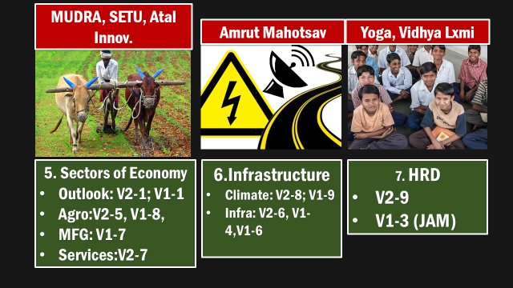

Slide 2
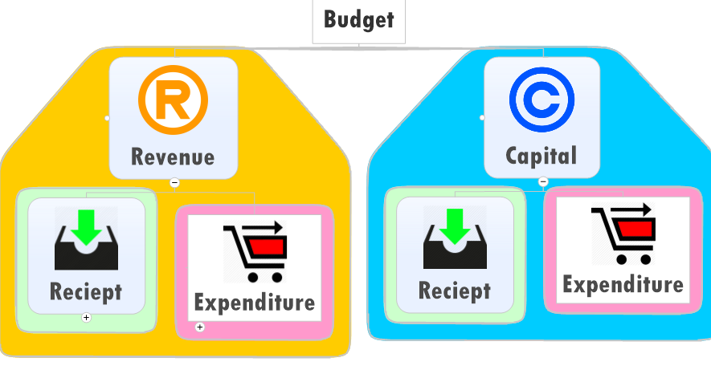

Slide 3
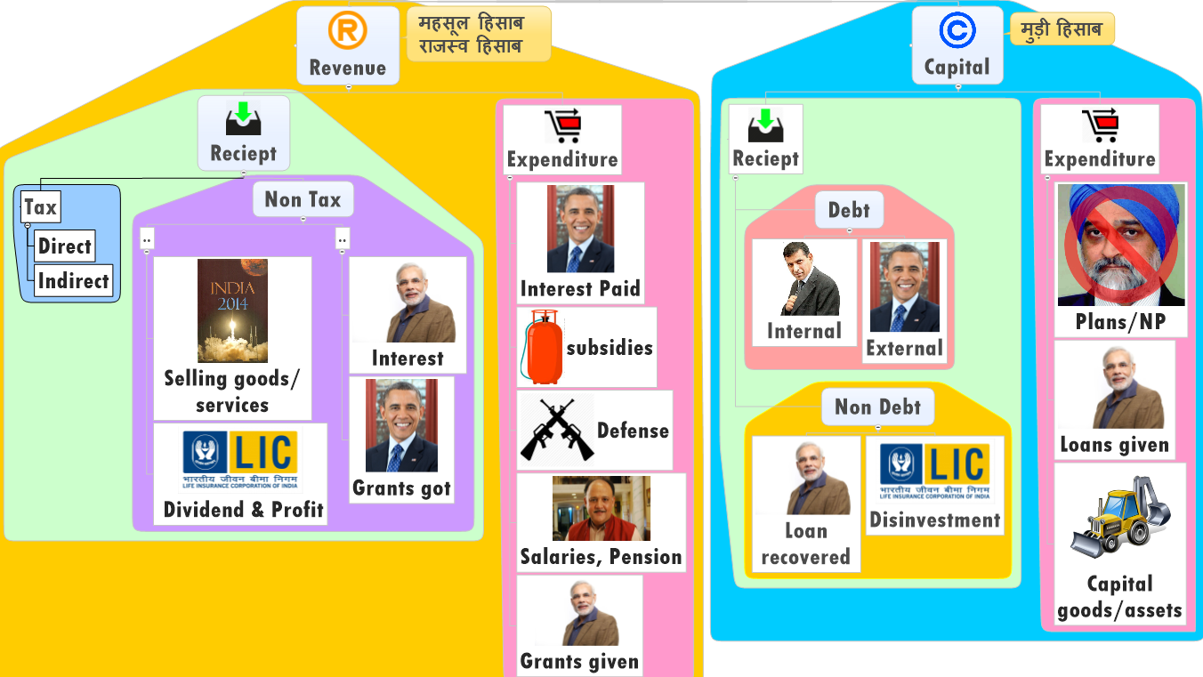
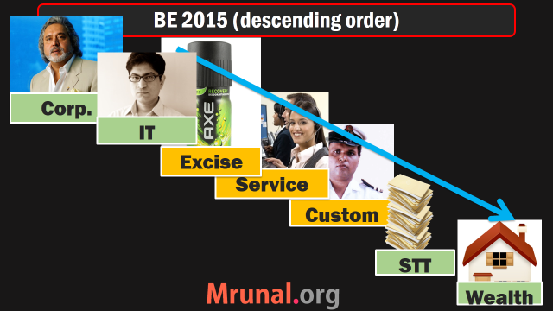
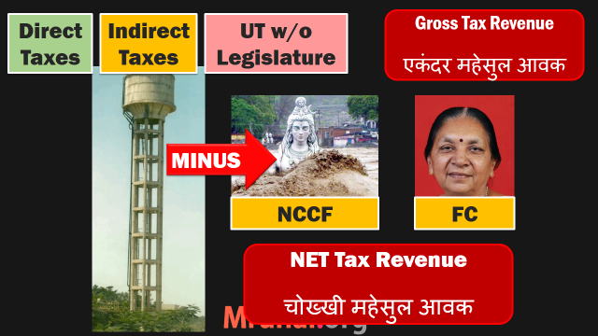

Slide 4
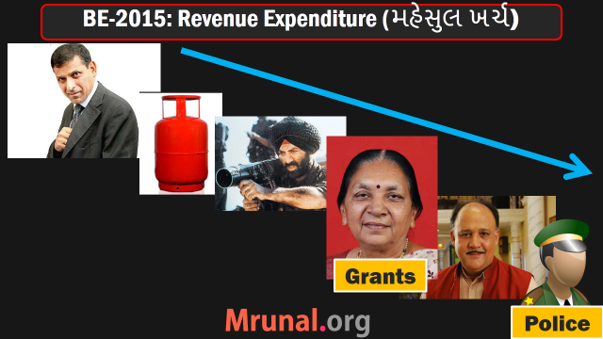

Slide 5
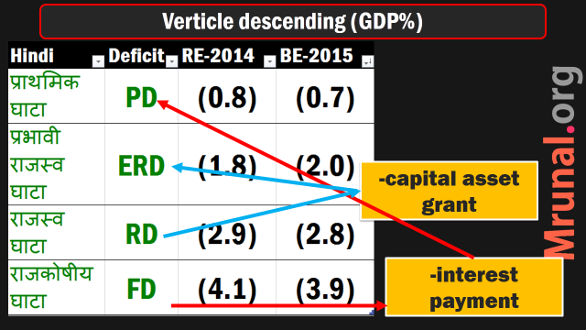
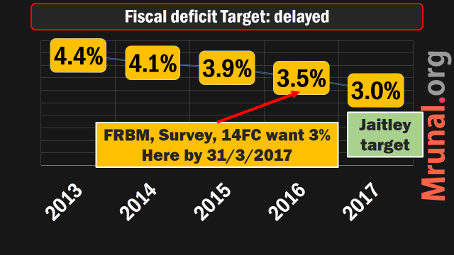

Slide 6
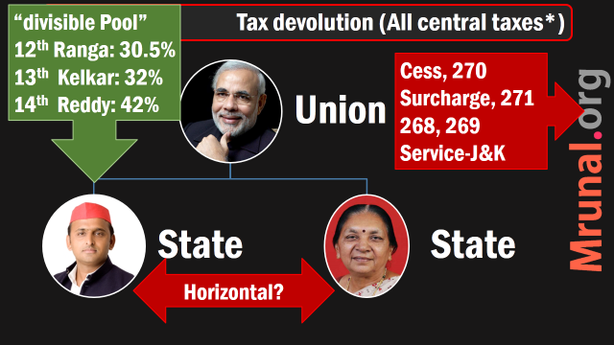
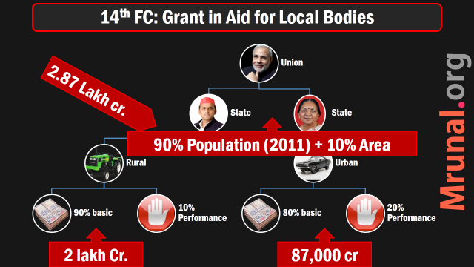
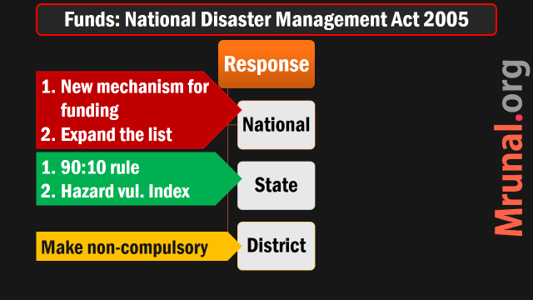

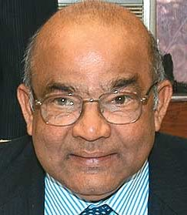

Slide 8
Good and services Tax :An Overview
C.A. Account keeping
Purpose of VAT / GST?
GST: Features & Benefits?
Challenges & Compensation?

Slide 9

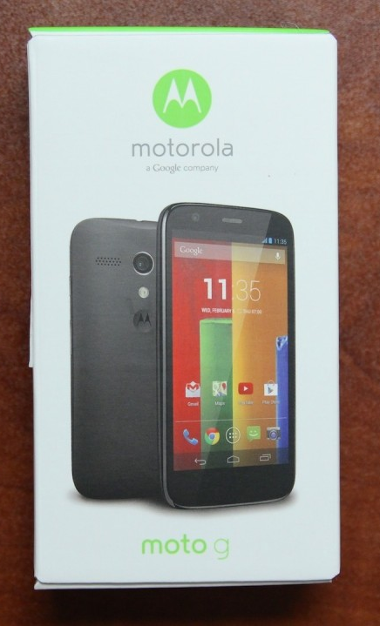
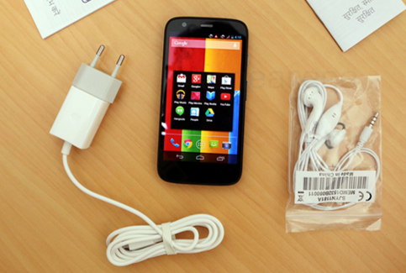

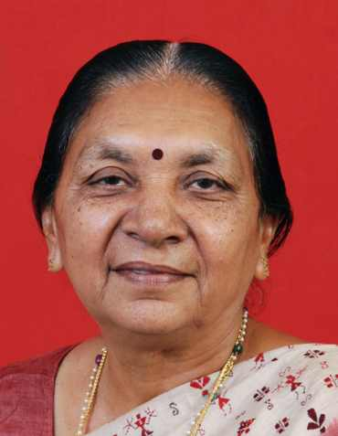
Rs.10,000
Rs.10,000/-
Rs.01,000/-
Rs.00,500
+500 Value added
Rs.1,000
Rs.11,500
Rs.1150
12,650
10% Sales Tax
10% Sales Tax
Final consumer

Slide 10
Rs.10,000
Rs.10000/-
Rs. 1000/-
Rs. 500/-
+500 Value added
11500
+01150
Rs.1,000
Rs.1,150
12,650
10% Sales Tax
1000+100+50
Final consumer

Slide 11
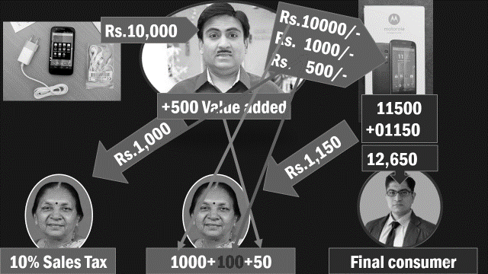
Why Sales tax system bad?
Cascading effect
Tax on tax
Sell without bill = no tax liability
Bribe the inspectors
Black money ▲
Fiscal deficit ▲

Slide 12
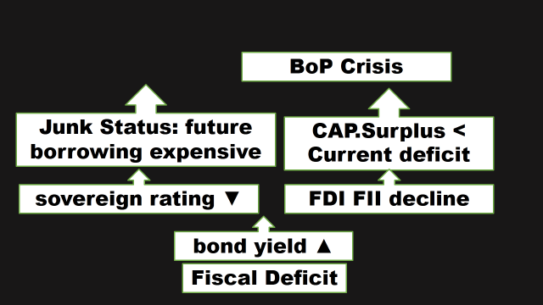
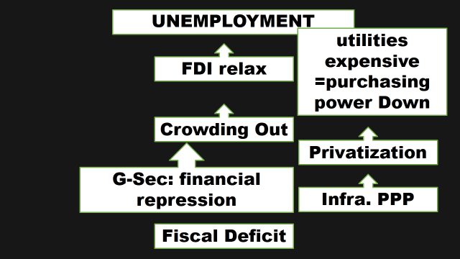
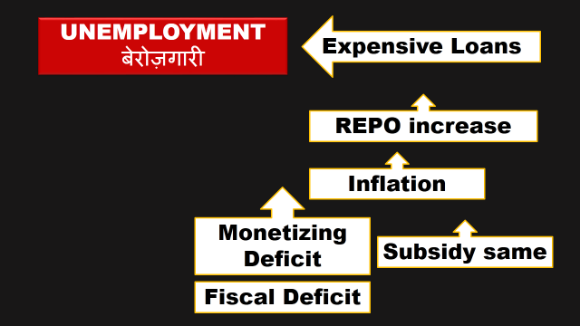
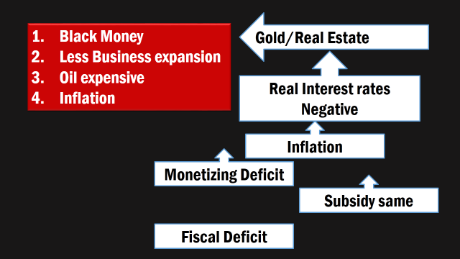
Solution?
VAT/GST

Slide 13
Rs.10,000
Rs.10000/-
Rs. 1000/-
Rs. 500/-
Input tax credit-1000
+500 Value added
10500
Rs.1,000
Rs.1,050
11,550
10% VAT
1000+____+50
Final consumer

Slide 14

Dealer’s liability: VAT on Output minus Input
Purchase (Input)
1000 Paid
Sales (Output)
1050 collected
Dealer’s VAT liability
Output – Input
=1050 MINUS 1000
=Rs.50 pay to state

Slide 15
January 2015: Input credit
Purchase (Input)
10,000 tax paid
Sales (Output)
5,000
Dealer’s VAT liability
Output – Input
=5,000 MINUS 10,000
=MINUS 5000 (input credit for future)

Slide 16

January 2015: Input credit
Purchase (Input) (10,000)
Sales (Output)
5,000
Dealer’s VAT liability
Output – Input
=5,000 MINUS 10,000
=MINUS 5000 (input credit for future)
Input Credit Rs.5000
TIN- Tax id.#

Slide 17
Feb 2015: no new stock purchased
Purchase (Input) (00)
Sales (Output)
7,000
Dealer’s VAT liability
Output – Input
=7000 MINUS 00
=(+)7000 pay to state government
Input Credit Rs.5000

Slide 18
Feb 2015: no new stock purchased
Purchase (Input) (00)
Sales (Output)
7,000
Dealer’s VAT liability
Output – Input
=7000 MINUS 00
=(+)7000 -5000
=Rs. 2000 pay to State Government
Input Credit Rs.5000
Input Credit Rs.00

Slide 19
January
February
VAT Paid on inputs | 10,000
VAT To be Paid on outputs | 5000
“Input” Credit received | (+) Rs.5000
VAT Paid on inputs | 0 (no new stock)
VAT on outputs | 7000
Trade to pay | 7k-5k=2k to Government
Have to buy and sell with invoice & TIN
Else no input credit.
With bill = less “inspector’ bribes
Tax collection ▲ => fiscal deficit ▼

Slide 20

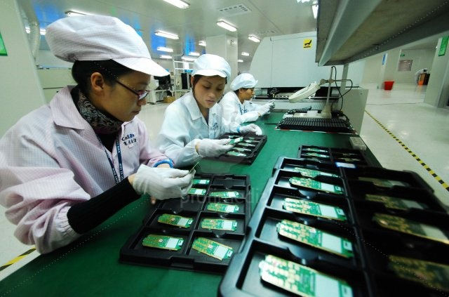
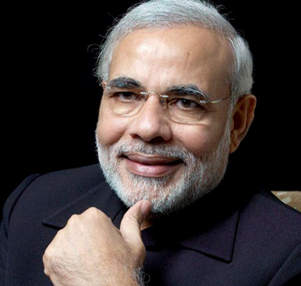
Cascading Effect
Tax on tax removed
Manufacturing
Excise Duty
Sales
Sales Tax
VAT
2005
Final consumer

Slide 21

Interstate
Central Sales
Tax (CST)
Manufacturing
Excise Duty
VAT
VAT

Slide 22
Sales tax: cascading effect
VAT: input credit
NEXT: MODVAT & CENVAT

Slide 23
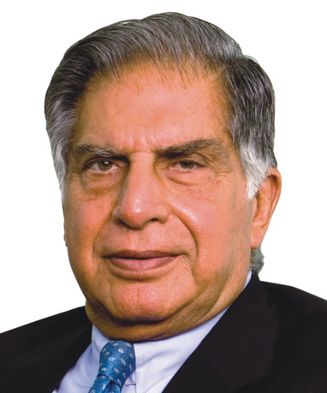

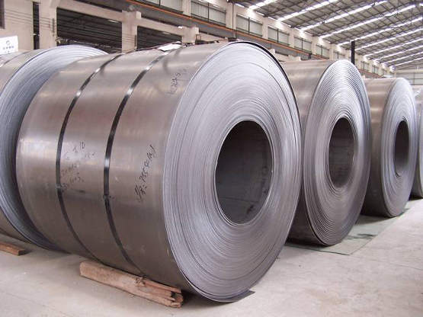
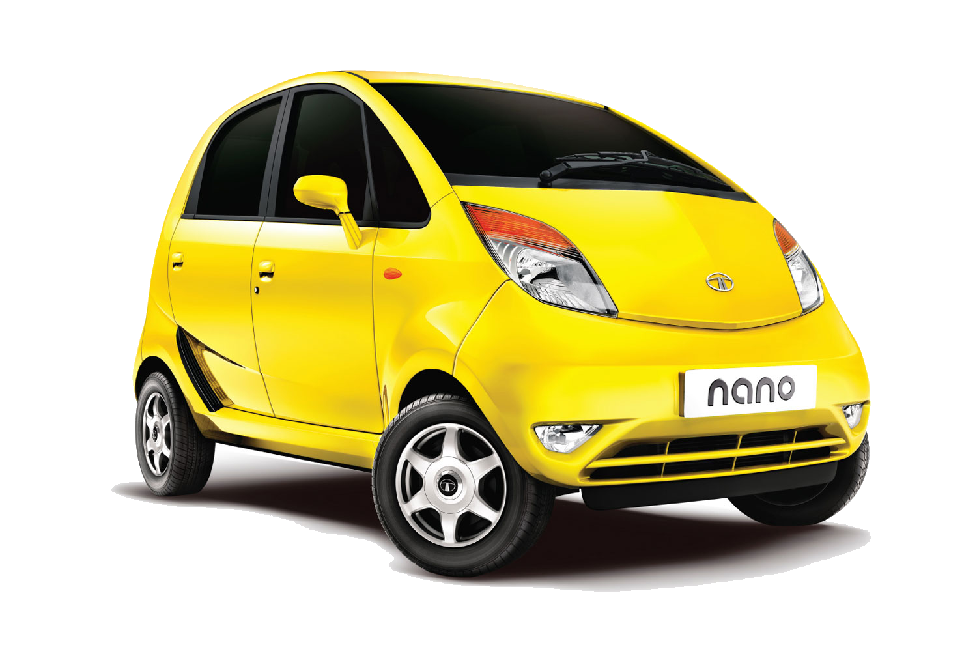
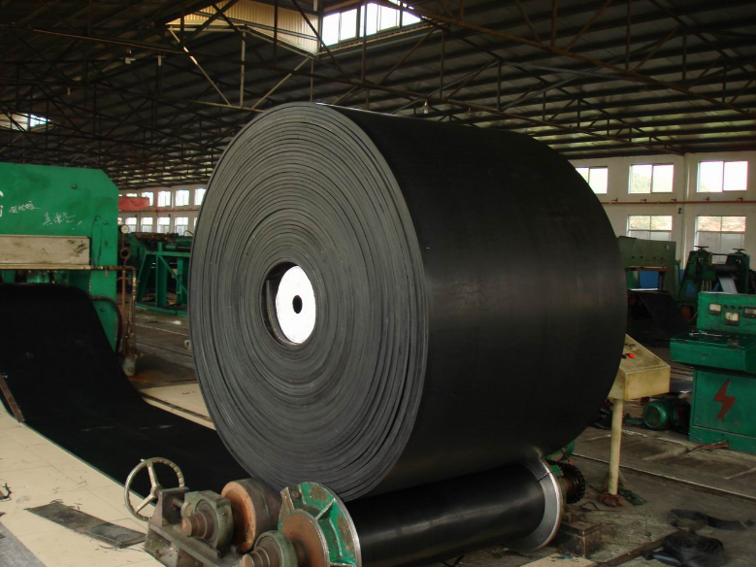

Excise applies on “Manufacturing”
cascading
cascading
Excise
Excise
cascading
Excise
Excise
Excise

Slide 24
MODVAT: Modified Value Added Tax regime
cascading
cascading
Input Credit
Excise
Excise
cascading
Excise
Excise
Excise

Slide 25


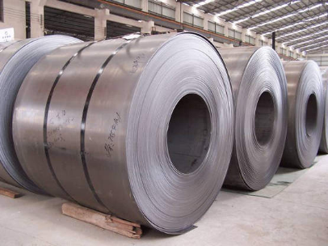

CENVAT: Modified Central Value Added Tax regime
cascading
Service tax
Input Credit
Excise
cascading
Excise

Slide 26
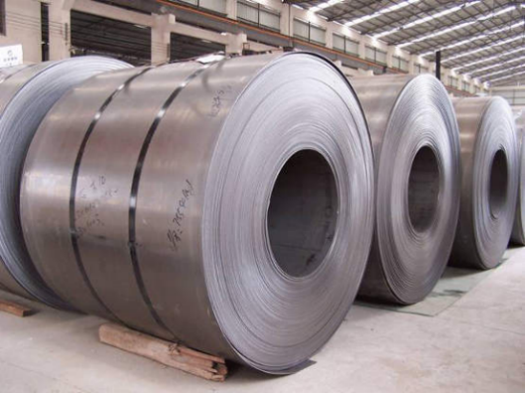
MODVAT?
CENVAT
Input credit on excise paid
For raw materials
For components
Input credit on excise and service tax paid
For raw materials, components used.
For services used.

Slide 27

A Timeline
VAT
Mid-50s: the French implemented
Late 70s: LK Jha Committee suggest MANVAT, implemented as “MODVAT”
MODVAT provides input credit on excise paid for raw material and components
CENVAT provides input credit on both excise and service taxes paid for manufacturing
Notes:
German economist suggested before french

Slide 28
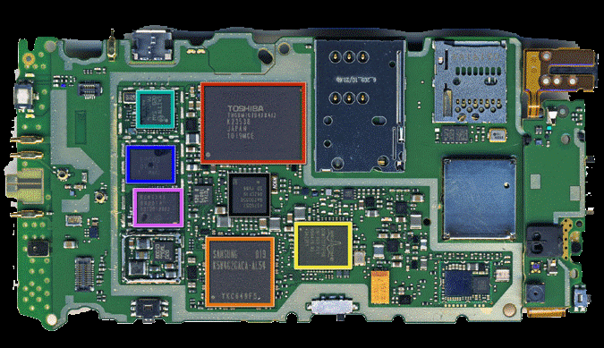

Excise
MODVAT
CENVAT
Credit
Manufacturing
Excise Duty
State VAT
Service tax

Slide 29
Cascading Effect: Tax on Tax
Evasion => “inspector” raj => bribery
VAT, CENVAT adopted to solve them.
Input credit, Self assessment
Random checks by State Commercial tax Department
Tax collection improved.
NEXT: Then why GST?

Slide 30
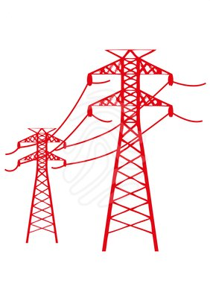


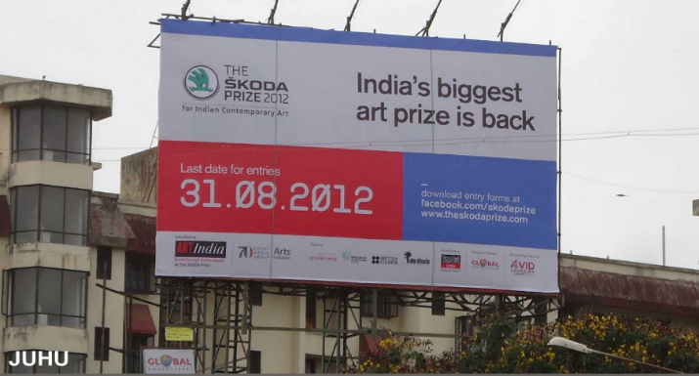

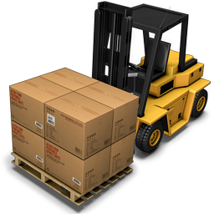
Service tax
Advertisement
Hoarding
Electricity
Cascading Effect
Continues
Fuels
CST
No “StateVAT” input credit

Slide 31

CENVAT & VAT input credit can’t offset eachother
Service tax
CENVAT credit
StateVAT credit
Excise
VAT

Slide 32

Problem Areas
VAT
Standard VAT rate 12.5%
But, Different rates across states.
0%, 1% to 20%
States demand cess, surcharge
Cartel formation with false invoicing to reduce VAT liability.

Slide 33
Why GST instead of VAT?
Uniform rates..X, Cess Surchase…Ye
Services covered…X
Input Credit for all “inputs”..X
Input Credit State vs Union

Slide 34

WHY?
GST
Covers Both goods and services
Covers MOST of union and state Indirect taxes
MOST Cess and surcharges Gone
Minimum exemptions
Used in Federal countries like Canada, NZ, Australia
Their revenue, GDP and exports ▲

Slide 35

Timeline
GST
2004: Kelkar Fiscal consolidation Task force recommends GST.
2008 Budget: planned to launch from 2010
2009: Empowered Committee of state finance ministers

Slide 36
Cascading Effect
Central GST
Mfg-Excise, services, Cess, Surcharge
State GST
VAT, Cess, Surcharge etc.
Final consumer

Slide 37
Gujarat to UP
Interstate
Commerce
Central GST
Integrated
GST
Central Sales Tax
State GST
State GST
Origin / exporter state
Destination based tax

Slide 38
Amendment Timeline
GST
Old Tax abolished: must amendment 7th schedule
115th Amendment 2011
Lapsed in LS
122nd Amendment 2014 in LS
Implement from 2016, 1st April

Slide 39
GST council: 3/4th majority for decision
Finance Minister
State Min. for
Finance
Taxation
Other
Union M.of State
Finance/ Revenue
Quorum: 50% of total membership
union
Voting Power
1/3rd
States voting Power: 2/3rd
Notes:
3/4th majority of Present and voting

Slide 40

Structure
GST Council
President will setup
Article 279-A
Finmin Chairman
1 Vice chairman
Within 60 days of act coming to force

Slide 41
Functions
GST Council
Decide which union and state taxes, cess, surcharge to subsume.
Exempted goods-services
Registration threshold limit
Interstate commerce- principles on sharing taxes with states (IGST system)
Notes:
special provision with
respect to Arunachal Pradesh, Jammu and
Kashmir, Manipur, Meghalaya, Mizoram,
Nagaland, Sikkim, Tripura, Himachal Pradesh and
Uttarakhand;

Slide 42
Functions
GST Council
floor-rates (above prescribed GST rates)
Special rates during calamity
Special category states (Ref 14th FC PPT)
Dispute settlement: modalities yet to be worked out.
Notes:
special provision with
respect to Arunachal Pradesh, Jammu and
Kashmir, Manipur, Meghalaya, Mizoram,
Nagaland, Sikkim, Tripura, Himachal Pradesh and
Uttarakhand;

Slide 43
GST council decides 3 GST Components
Integrated GST
(IGST: NOT A Tax, but SYSTEM)
Central Sales Tax
State GST
State indirect taxes*
Central GST
Central indirect taxes*
Notes:
* - not all taxes subsumed

Slide 44
GST subsumes what?
Direct taxes of union and state….NO
All indirect taxes of union and states…NO
Selected indirect taxes of union and states….yes

Slide 45
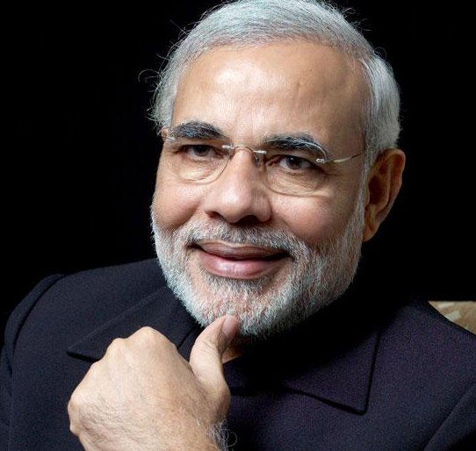
Kept outside/ Delayed
Central GST
Custom Duty..no, kept outside. + imported product subject to “IGST”
Cess on Custom duty.. Applicable.
Tobacco product…GST yes, but central excise also
Petroleum products….only after council declares date [Crude Oil, HSD, Petrol, Natural Gas, ATF]
Notes:
Further, the GST Council is to decide when
GST would be levied on: (i) petroleum crude, (ii)
high speed diesel, (iii) motor spirit (petrol), (iv)
natural gas, and (v) aviation turbine fuel.

Slide 46
Central indirect taxes gone
Central GST
Central Excise duty
Central Sales Tax
Service Tax
Counter Veiling Duty (CVD)
Special Addl. Duty of Customs (SAD)
Excise Medi. + Toi. Prep. With alcohol
Cess and Surcharges gone
Notes:
Further, the GST Council is to decide when
GST would be levied on: (i) petroleum crude, (ii)
high speed diesel, (iii) motor spirit (petrol), (iv)
natural gas, and (v) aviation turbine fuel.

Slide 47
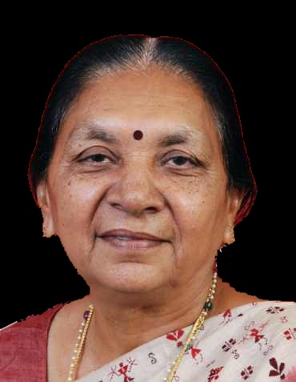
State taxes not gone
SGST
Excise on liquor for humans
Stamp Duty on immovable property
Electricity Duty & cess
Petroleum products….only after GST council declares date

Slide 48
State indirect taxes gone
State-GST
State VAT
Luxury tax
purchase tax
entry tax, Octroi
entertainment tax (but of not local body)
Lottery, betting, gambling

Slide 49
122nd Bill ARTICLES
GST
2014, December, LS
246-A
States given power to tax goods and services
But only union to tax inter-state commerce of goods and services

Slide 50
Constitutional angle
GST
269-A: Union IGST, parliament to legislate. Money distribution as per GST council recommendations.
279-A: GST council by President
270: CGST (union portion OF INDIRECT TAXES) will be distributed between Union and states….as per Finance commission

Slide 51
How to pass the bill?
122nd Bill
No concurrent taxation power @present.
GST: Changes federal relations
2/3rd majority of each house
At least 50% state assemblies (15)
122nd Amendment “act” 2014
GST Implement from 1/4/2016

Slide 52
So far
Sales Tax vs VAT
CENVAT MODVAT
GST: Why and HOW?

Slide 53
GST Benefits
IGST: efficient logistics
Ancillarisation
Same “Base” computation
Zero rated Exports
Both goods and services
Standard rates
Min. exemptions
Biz Expand, Jobs, GDP, ▲
Tax base, collection

Slide 54

Logistics Warehousing
CST
Central Sales Tax (CST) Act 1956
Std. rate: 2%, If bought for ‘resale/mfg’. [form “C”]
Otherwise higher rate (~4%)
CST origin based tax. Exporter state keeps money.
CST “input credits” can offset only CST liabilities

Slide 55
logistics Warehousing
CST
Inter-state “Commerce” not “transport”.
So, Companies maintain depots in all major states of India to avoid tax burden.

Slide 56
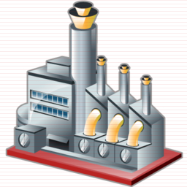
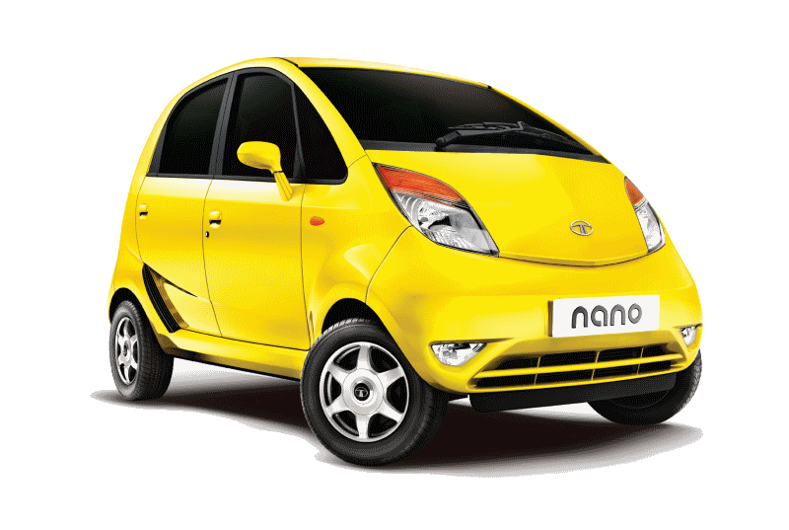
VAT/CST system: Warehousing obsession
CST
Excise
VAT

Slide 57

VAT/CST system: Warehousing obsession
CST
Excise
VAT

Slide 58
Warehousing obsession
VAT / CST
Big corporates, E-Commerce sites can setup warehouses / depots everywhere
To dodge CST liability
Tax burden on their product LOW
MSME can’t compete price wise.
“checkposts”: bribery
Solution: IGST

Slide 59
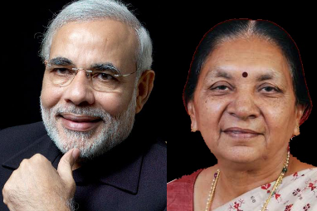
NOT A “TAX” but a “System”
IGST
IGST: Integrated goods and services tax
IGST is not a “Tax”. (like CST=2%)
Nano CAR mfg. 12% CGST (Excise)
Nano CAR sales. 14% SGST (VAT)
IGST: CGST + SGST
IGST: 12 + 14 = 26%

Slide 60
IGST is not a “TAX” But CGST+SGST
IGST: 26%
CGST (12%)
SGST (14%)

Slide 61
GST : “Input Credit”
CGST Credit
20,000
SGST credit
20,000
Demand 12k
Demand 14k

Slide 62
GST : “Input Credit”
CGST: 12,000
IGST: 26,000
SGST: 14,000
CGST Credit
20,000
SGST credit
20,000
Demand 12k
Demand 14k

Slide 63
GST : “Input Credit”
IGST collected: 26,000
CGST: 12,000
SGST: 14,000
CGST Credit
20,000
SGST credit
20,000
CGST Credit
8,000
SGST credit
6,000
Input credit transferred to “Destination State”
Demand 12k
Demand 14k

Slide 64
Credit on raw material from outside the state
IGST Paid: 20,000
CGST: 10,000
SGST: 10,000
CGST Credit
8,000
SGST credit
6,000
CGST Credit
18,000
SGST credit
16,000

Slide 65
Businessman’s GST liability= Output - Input
Sale in Guj
Sale in UP
CGST Credit
8,000
SGST credit
6,000
CGST Credit
18,000
SGST credit
16,000

Slide 66
रट्टा मारो जिंदाबाद
IGST
IGST made up of __ + __?
IGST will be levied by Union Government
CGST transferred to Union
SGST Input credit transferred from “exporter state” to “Importing state” (destination state)

Slide 67
रट्टा मारो जिंदाबाद
IGST
CGST input credit used for payment of CGST to union (not state)
SGST credit for paying to State Government (not union)
Two input tax credit (ITC) streams can’t be cross utilized.
Dealer’s liability: Output – input.
Warehousing = no tax dodging benefit anymore.

Slide 68
GST Benefits
IGST: efficient logistics
Ancillarisation
Same “Base” computation
Zero rated Exports
Both goods and services
Standard rates
Min. exemptions
Biz Expand, Jobs, GDP, ▲
Tax base ▲

Slide 69
Excise
Excise
Manufacturing
Excise Duty
Sales
State VAT
CST
Service tax
Service tax
CENVAT credit
StateVAT credit
Notes:
Not interchangable

Slide 70
To ▼tax burden & cascading effects
Company tries “in-house” production of everything
Depots/warehouses
State VAT
Excise

Slide 71

CGST
CGST
SGST
CST
Credit on input so….
Division of labour
Anciliarization
Outsourcing
Subcontracting
MSME + jobs
Direct + indirect
Tax base increased
CGST
CENVAT credit
StateVAT credit

Slide 72
GST Benefits
IGST: efficient logistics
Ancillarisation
Same “Base” computation
Zero rated Exports
Both goods and services
Standard rates
Min. exemptions
Biz Expand, Jobs, GDP, ▲
Tax base ▲

Slide 73
present
Rs.10,000
Rs.11,000
10% Excise
12% VAT
1,000
1,320
Notes:
Final price is 9% less

Slide 74
present
GST
Same “BASE”
=overall less tax
On customer
Rs.11,000
Rs.10,000
Rs.10,000
10% CGST
12% SGST
10% Excise
12% VAT
1,000
1,320
1,000
1,200
Notes:
Final price is 9% less

Slide 75

4th benefit GST: Exports will be zero rated.
Finished
Product
Export
Raw
material
import
Manufacturing
CGST
Customs
+IGST
0% GST

Slide 76
January
GST Paid on inputs | 10,000
GST To be Paid on “EXPORTS” | 0
“Input” Credit received | (+) Rs.10,000
Export “ZERO rated”
Exporter gets credit for the GST paid on inputs
BUT have to sell with bill, else no credit=> tax evasion prevented

Slide 77
GST Benefits
IGST: efficient logistics
Ancillarisation
Same “Base” computation
Zero rated Exports
Both goods and services
Standard rates
Min. exemptions
Biz Expand, Jobs, GDP, ▲
Tax base ▲

Slide 78
Sales Tax vs VAT
CENVAT MODVAT
GST: Why and HOW?
GST: Benefits

Slide 79
GST: Challenges /Negative Points
Misc.
Registration?
Compensation?
High RNR

Slide 80
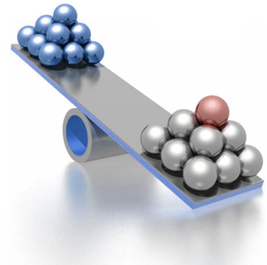
What and WHY?
RNR
Revenue neutral rate
If Union abolishes service, excise and various cess surcharges=> revenue income ▼
So whatever CGST is planned- its rate should be ▲ enough to sustain same money flow according to GDP
Same for State taxes=> SGST

Slide 81
Excise: 12.5%
VAT
12.5- 14.5
Service: 14%
CGST: ~12.77%
SGST: ~13.91%
Total GST
26.68%

Slide 82
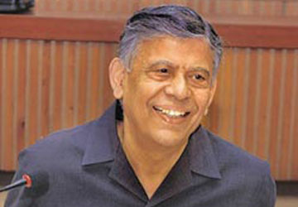
13th FC Taskforce
State Empowered Committee
7% State GST
5% Central GST
12% GST
Central GST: 12.77%
State GST: 13.91%
Total GST: 26.68%

Slide 83
GST rates across world
Adopted in 1994
Launch: 1/4/15

Slide 84
If combined GST 26-27% then?
RNR
Competitive edge Asian giants ▼
domestic industry will be ruined (says FICCI)
Evasion and Smuggling ▲
Higher GST = More regressive on poor + inflation = purchasing power ▼

Slide 85

Solution?
RNR
High RNR because Governments want same revenue flow.
Include petrol, liquor, land, electricity within GST ambit.
“Exemption” in rarest of rare cases only.
Thus, ▲ tax base =>RNR can be ▼

Slide 86
GST: Challenges /Negative Points
Misc.
Registration?
Compensation?
High RNR 27%?

Slide 87
Why states demand compensation
GST
Union: Highest collection from corporate (Direct tax)….outside GST
States: highest collection from VAT….gone under GST
Many state taxes, cess, surcharge gone
Revenue loss to states.
States will be at mercy of FC, to get share from union taxes ☹
+ Destination based tax not good for industrialized states

Slide 88

GST: Destination based tax- industrialized states unhappy
IGST
CGST
In CST- could keep
But GST “Exporter”
State Gets Nothing ☹
SGST credits transferred to
Destination (importer state)

Slide 89
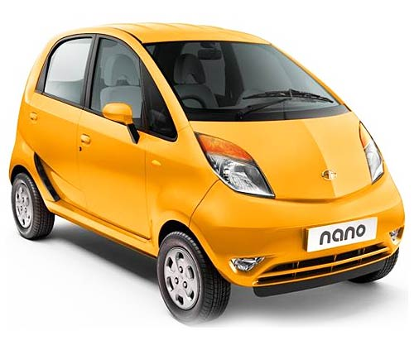
GST: Destination based tax: temporary relief.
1% tax
2 years
IGST
Temporary compensation
SGST
(Destination)
Notes:
A non-vatable additional tax, not exceeding 1 per cent on inter-state supply of goods would be levied by
the centre and retained by the originating state at least for a period of two years.

Slide 90
14th FC
GST
GST Rates undecided.
How many taxes subsumed: Unclear
Hence, Difficult to gauge losses
But union will have to compensate
=fiscal burden
But mid-long term will recover through higher GDP => higher revenue collection

Slide 91
14th FC Compensate?
GST
122nd Amendment bill provides for compensation for five years.
14th FC: Autonomous “GST compensation fund” through law with “tapering effect”

Slide 92
Reduce compensation over the years
Tapering

Slide 93
GST: Challenges /Negative Points
Misc.
Registration?
Compensation?
RNR?

Slide 94
Who has to register?
GST
VAT: 11 digit Tax identification number (TIN) for “input credit”
Registration thresholds:
VAT: 5 lakh (?)
Service tax: 10 lakh
Excise: 1.5 crore (?)
GST: common threshold. But how much?

Slide 95

Union says
States demand
Compulsory registration: 25 lakh turnover
Special category: 5 lakh
General category: 10 lakh
Lower threshold = more traders covered= broader tax base = more income

Slide 96
Database challenge
GST
~1 lakh excise assesses
~8 lakh service tax assesses
GST: ~30 lakh assesses
Data Management issues.
Goods and Services Tax Network (GSTN) ltd to give ICT services.

Slide 97
GST: Challenges /Negative Points
Misc.
Registration?
Compensation?
RNR: 27%?

Slide 98
Petroleum products
GST
Petroleum products kept outside until GST council notifies date.
=Excise, CST and VAT applicable.
▼ Crude oil = ▲ Excise raised to increase revenue collection.
Even if covered in GST: standard rates. Will fuel inefficient car made to pay ▲ ?

Slide 99
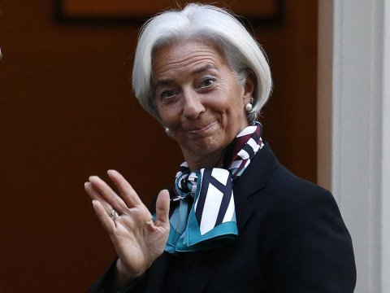
Indian GST challange
IMF
Dual rates: complex structure- registration, credit, compensation
Union to coordinate with 30 states for “Input Credits”
State tax officials untrained, inept
IT infrastructure @state level: missing
Although can add 1-1.5% in GDP growth rate

Slide 100
Sales Tax vs VAT
CENVAT MODVAT
GST: Why and HOW?
GST: Benefits
GST: Challenges
GDP

